Slide 1
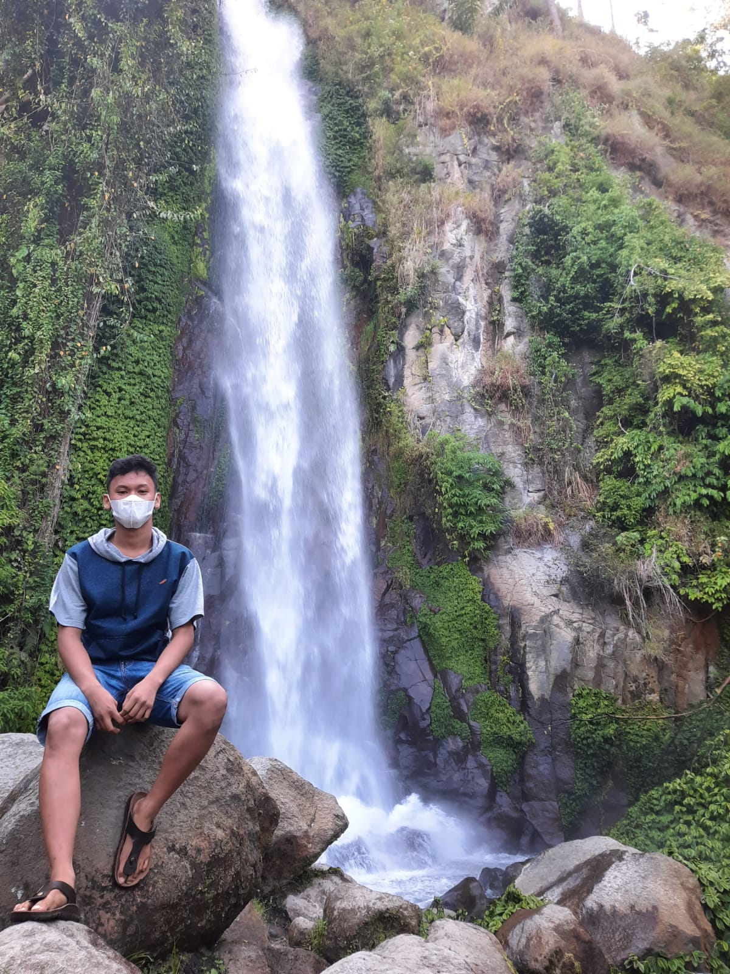


KELOMPOK 19
JOSUA PRATAMA MARBUN_13321028
DION SAPUTRA MANURUNG_13321008
PUTRA REZEKI SILAEN_13321010

Slide 2
OUTLINE
1. Introduction
2. System Overview
3. Functions
4. Use Case Diagram
5. ER Diagram
6. Architecture Style
7. Demo Product

Slide 3
1. Introduction
TOPIC
BACKGROUND
OBJECTIVES

Slide 4
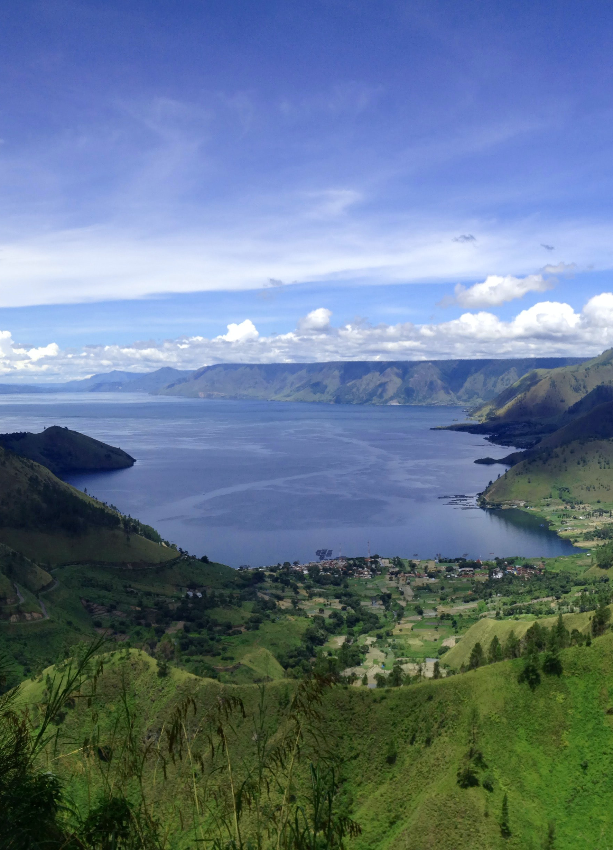
TOPIC : WEBSITE PROFILE KELURAHAN SANGKAR NIHUTA
1. Introduction
BACKGROUND :
The background of the website profile for the Sangkar Nihuta Village is due to the lack of introduction to the Sangkar Nihuta Village in Balige City, North Sumatra, so the development team took up this topic and built a website that can provide information about the Sangkar Nihuta Village, so that the wider community can get to know more deeply. about the Nihuta cage village.

Slide 5
OBJECTIVES
The purpose of making this website profile is as an information system, which helps the community of Sangkar Nihuta to be known through the website that was built, and so that outsiders know how the location of the Sangkar Nihuta village is, the area, and the organizational structure of the Sangkar Nihuta village.

Slide 6
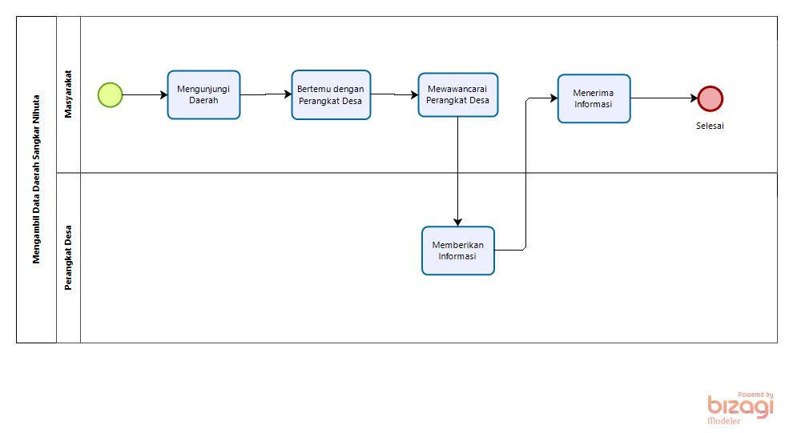
2. System Overview
CURRENT SYSTEM
In the current system, it involves community interaction with the village apparatus which uses the system that was built. Which at this time there are still many who do not know the Sangkar Nihuta village as a village located in the province of North Sumatra, and which is located in Toba Samosir district, Balige sub-district.

Slide 7
TARGET SYSTEM
Website Profile of Sangkar Nihuta Village is an information system for the introduction of one area. The system that was built also provides benefits to the village head and the wider community which provides information such as the features that exist in the system that has been built, namely the organizational structure features, area area features, population features.

Slide 8
3. Functions
REGISTRASI FUNCTION
LOGIN FUNCTION
GOVERNMENTFUNCTION
INFOGRAFIS FUNCTION
NEWS FUNCTION
MAKE A COMMENT FUNCTION
LOGOUT FUNCTION

Slide 9
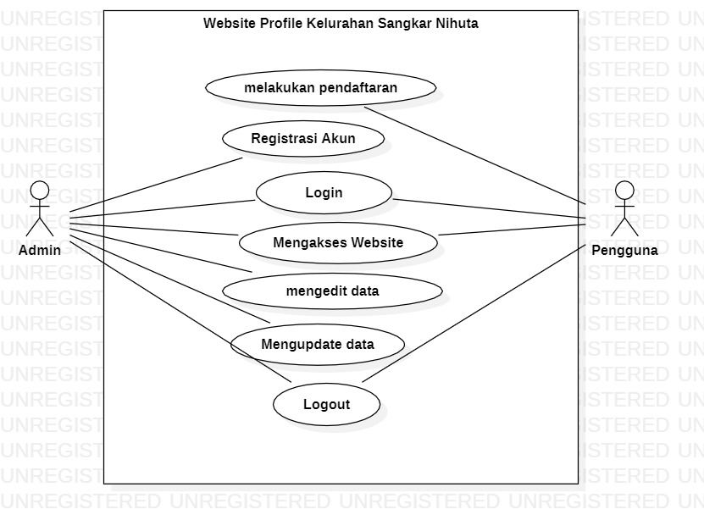
4. Use Case Diagram

Slide 10
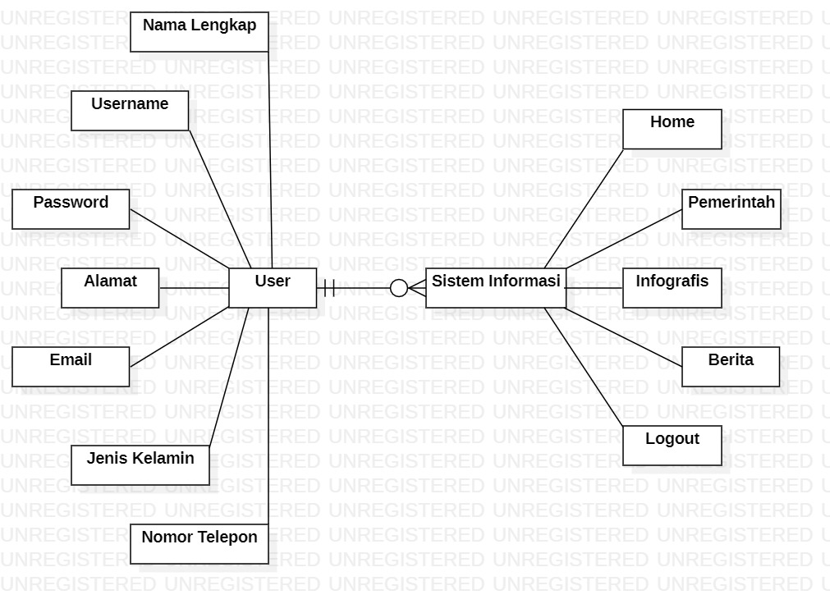
5. ER Diagram

Slide 11
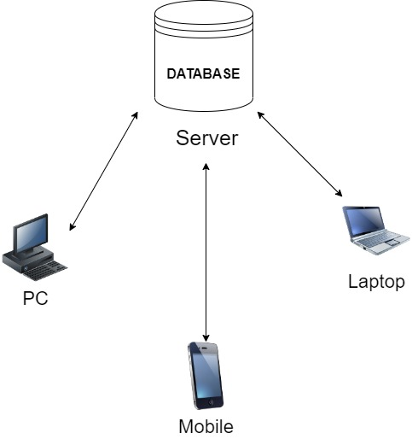
6. Architecture Style
The architectural style used in the website profile of Sangkar Nihuta Village is Multiple Page Application (MPA) because the MPA architectural style uses several pages on the website that was built.

Slide 12
7. Demo Product

Slide 13
THANK YOU

